Slide 1
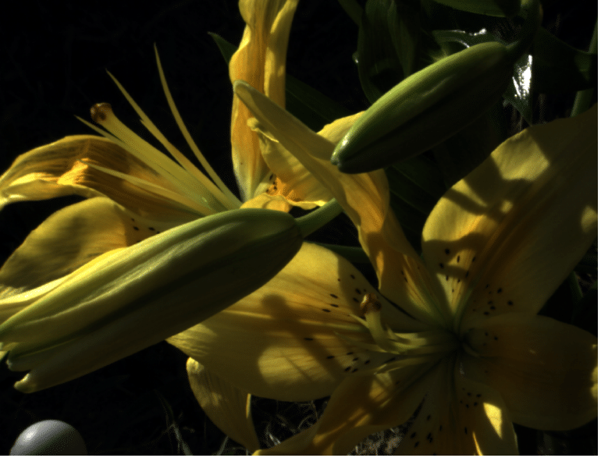
Camera: CANON 5D
Light Source: CIE Standard Illuminant A

Slide 2
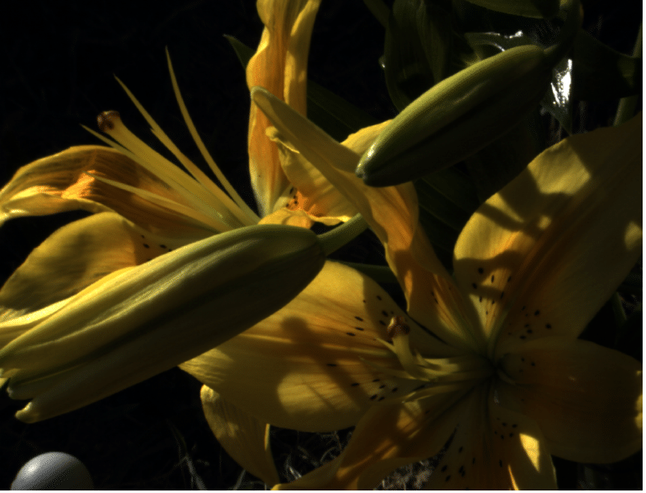
Camera: CANON 5D
Light Source: CIE Standard Illuminant D65

Slide 3
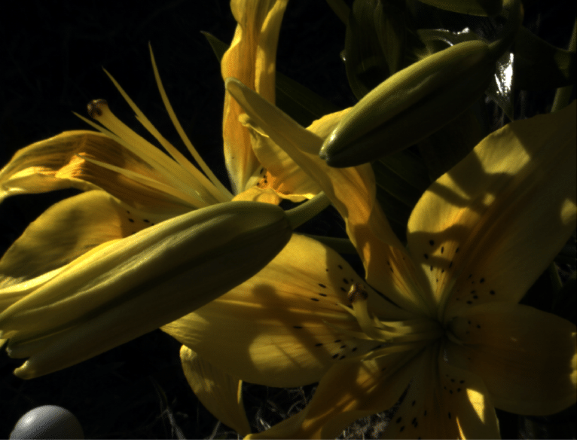
Camera: CANON 5D
Light Source: Fluorescent F1

Slide 4
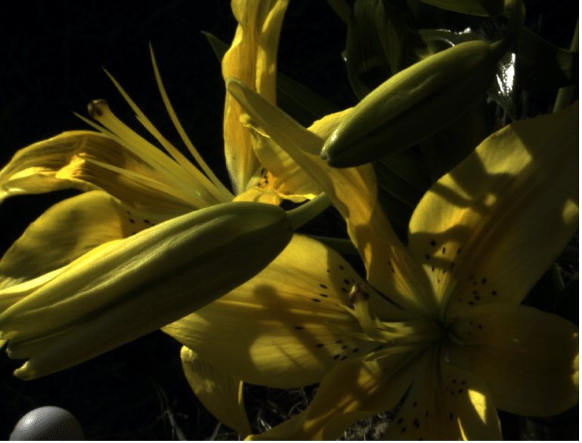
Camera: CANON 5D
Light Source: Fluorescent F2

Slide 5

Camera: CANON 5D
Light Source: Fluorescent F3

Slide 6

Camera: CANON 5D
Light Source: Fluorescent F4

Slide 7

Camera: CANON 5D
Light Source: Fluorescent F5

Slide 8

Camera: CANON 5D
Light Source: Fluorescent F6

Slide 9

Camera: CANON 5D
Light Source: Fluorescent F7

Slide 10

Camera: CANON 5D
Light Source: Fluorescent F8

Slide 11

Camera: CANON 5D
Light Source: Fluorescent F9

Slide 12

Camera: CANON 5D
Light Source: Fluorescent F10

Slide 13

Camera: CANON 5D
Light Source: Fluorescent F11

Slide 14

Camera: CANON 5D
Light Source: Fluorescent F12

